Slide 1
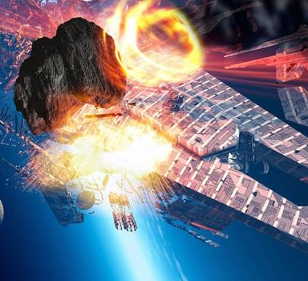
Predictability of Starlink orbits
Why is this important?
The number of satellites put into orbit has been sharply increasing in the past few years. Companies such as Starlink are not required by law to encrypt or keep a standard of security measures for satellites. This leaves them at risk of being hacked while in orbit. A hacker could take control of a satellites propulsion system and set it on a collision course with any other satellite, including telecommunications, GPS, or even the International Space Station. This poses a great risk to national security because the country could be left without internet or the ability to call emergency services for an extended period of time.

Slide 2
Timeline of number of satellites in orbit
2015
4,077 satellites in orbit
2016
4,256 satellites in orbit
2017
4,635 satellites in orbit
2018
4,857 satellites in orbit
2019
4,987 satellites in orbit
Data gathered from UNOOSA
(United Nations Office for Outer Space Affairs)

Slide 3
Methodologies
- Systems Tool Kit orbit determination tool
- STK conjunction analysis tool
- STK telemetry tool
Skyfield open source Python library

Slide 4
Low Earth Orbit satellites (LEO)
Low Earth Orbit is between 100 and 1,000 miles above the planet
Starlink satellites weigh 250 kg
Two-way communication between satellite and ground station uses tracking telemetry
Ground station is able to track the satellite, control its propulsion (Hall-effect thrusters), and monitor the temperature as well as voltages on board the satellite
Travel at about 7.28 – 7.70 km/s (orbit every 91 – 108 mins)
Directory.eoportal.org
Celestrak.com

Slide 5
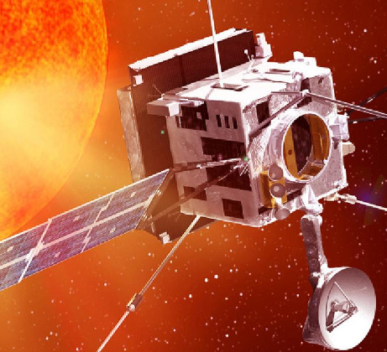
Compromised satellites
Hacked satellites could pose danger for other satellites or space vehicles
A hacker could take control of a satellite’s thrusters
If the thrusters are compromised a satellite’s eccentricity could be changed, altering the shape of the satellites orbit
NASA satellite battery fried by hacker aiming solar panels directly at the sun
Satellites which help our nation’s infrastructure could be rendered useless

Slide 6
Orbital equation in terms of angle
d^2u/dphi^2 = -u(phi) – mu/(l^2u(phi)^2) *F
Where F is universal gravitation force between two bodies, F=(G*m_1*m_2)/r^2
Mu = m_1*m_2/(m_1 + m_2) → known as reduced mass
r(phi)= c/(1+epsilon*cos(phi)) → eccentricity equation
If epsilon < 1, orbit is elliptical
If epsilon = 1, orbit is parabolic
If epsilon > 1, orbit is hyperbolic

Slide 7
References
https://earthdata.nasa.gov/esds/csdap/commercial-datasets
https://celestrak.com/NORAD/elements/supplemental/
https://celestrak.com/SOCRATES/
https://www.unoosa.org/oosa/osoindex/search-ng.jspx?lf_id=

